Slide 1
Unit 6: Managing Debt

Slide 2
Think, Pair, Share
What are the advantages of avoiding too much debt?

Slide 3
Managing Debt
Improves mental health by reducing worry about money
Have money to save and invest

Slide 4
How to Manage Debt
Use a budget
Limit expenses
Maintain a good credit score
Use credit wisely

Slide 5
Preview the Topic
What do you know about credit scores?
Why are they important?

Slide 6
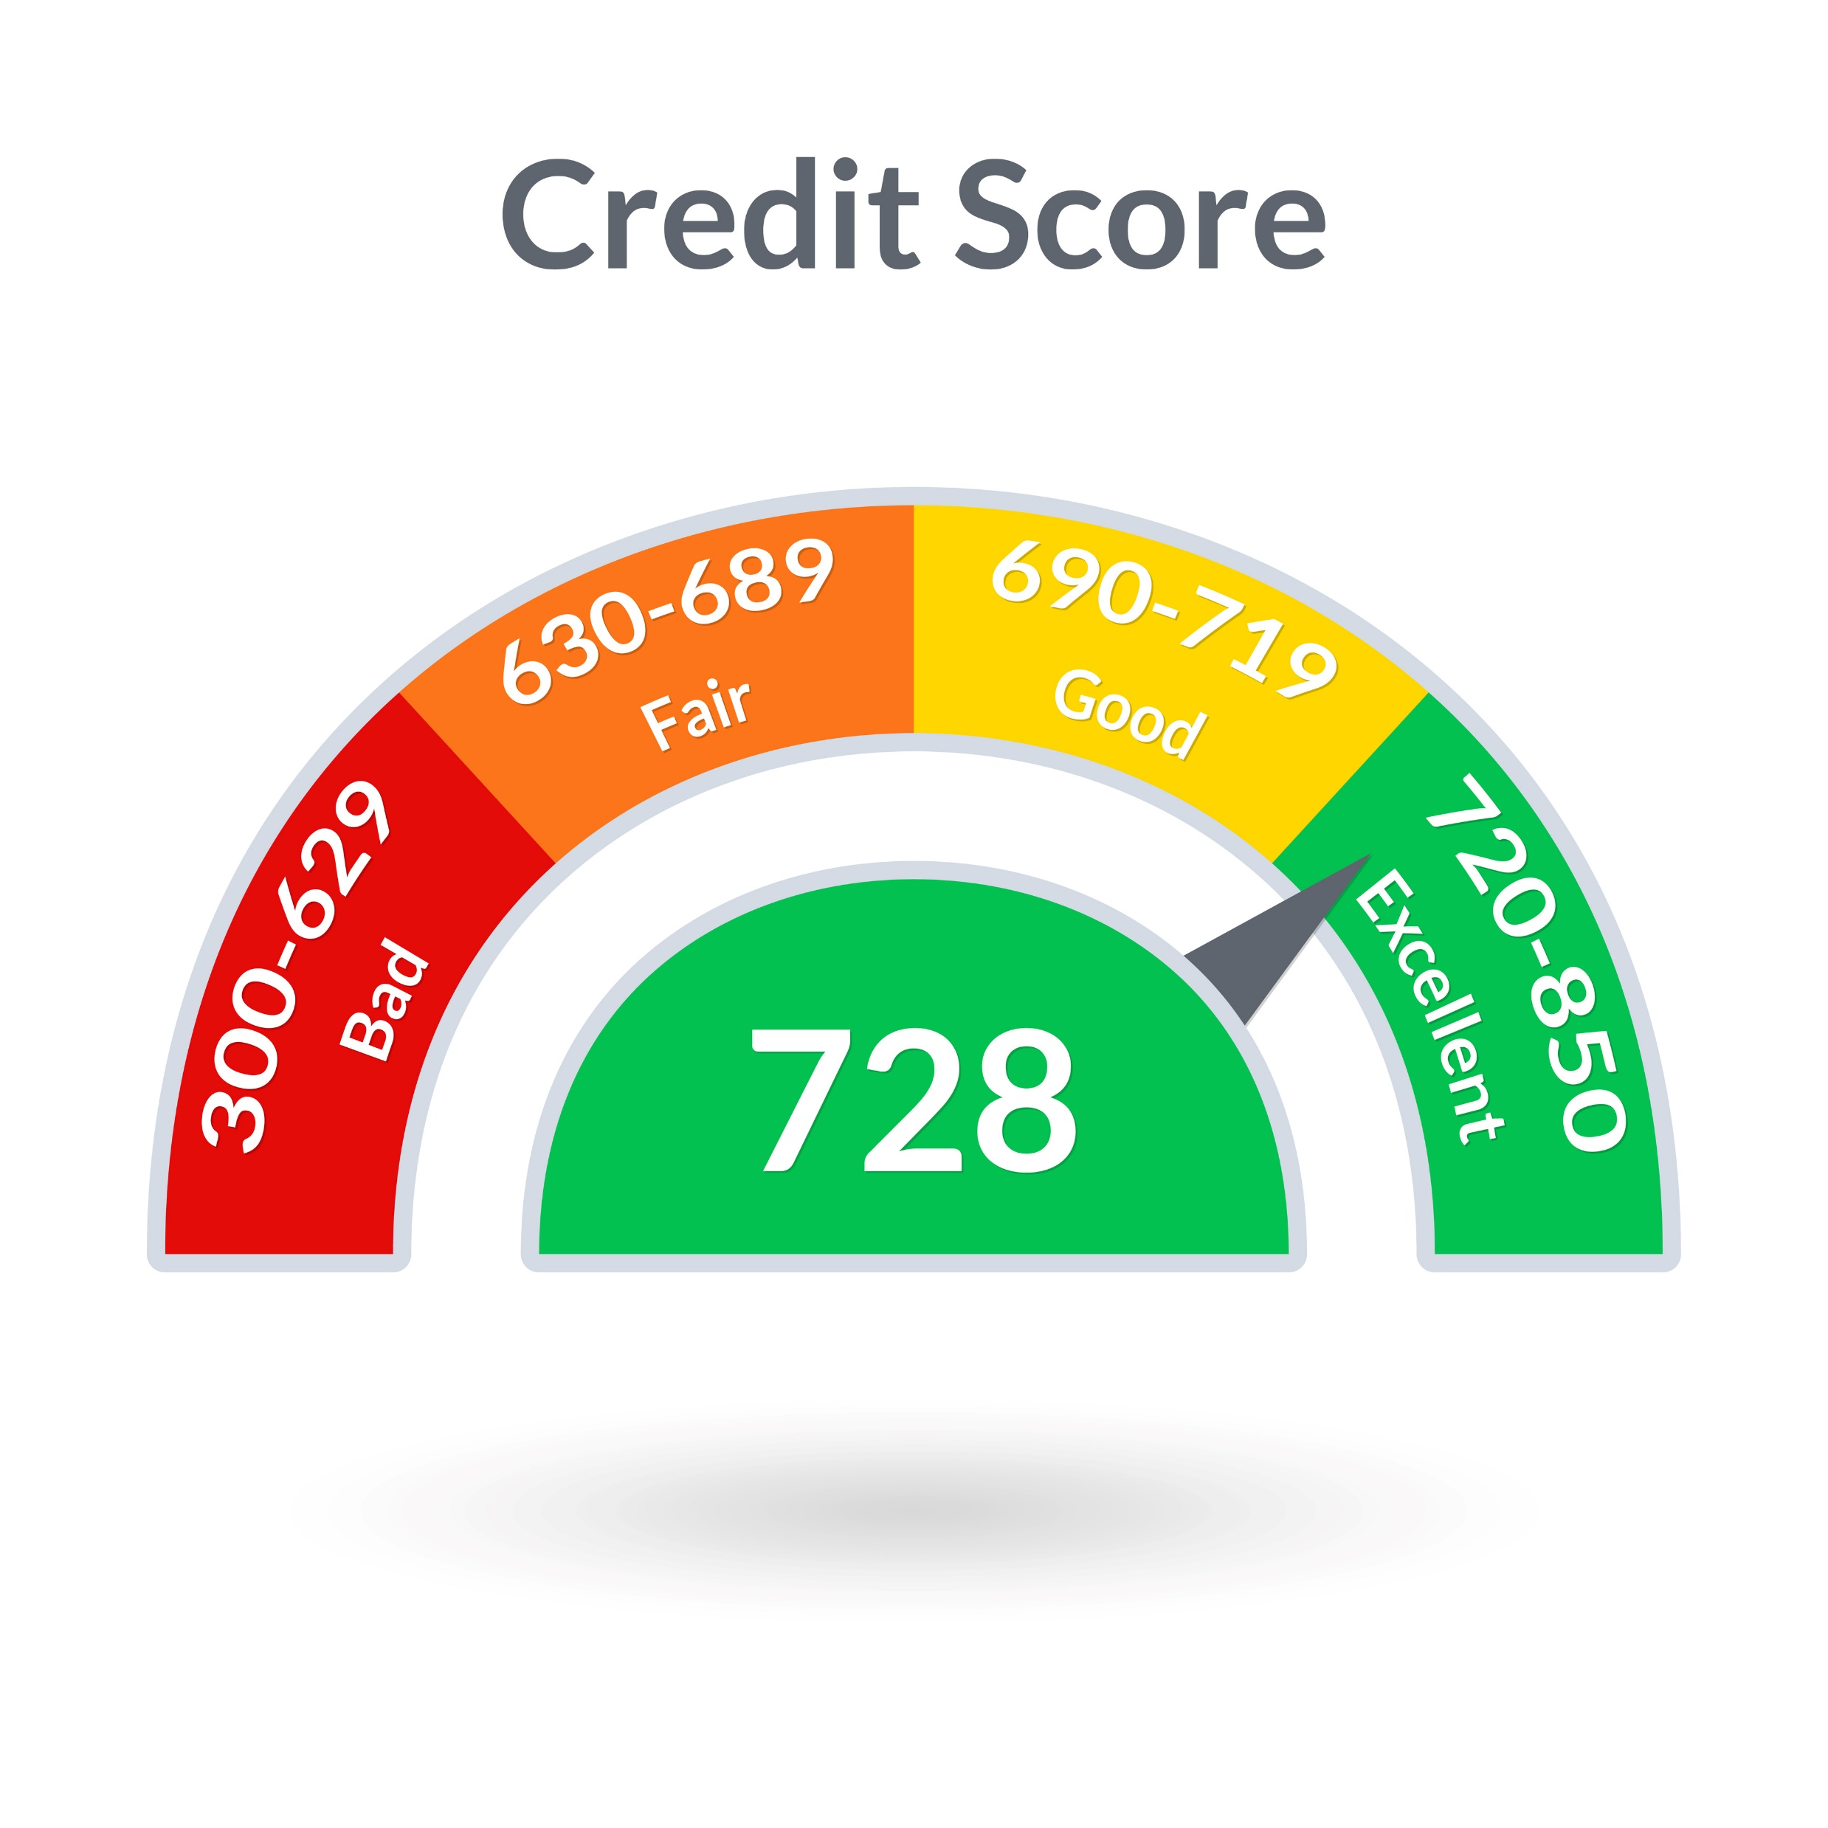
Understanding Your Credit Score
Your credit score predicts how likely you are to pay back a loan on time.

Slide 7
Why Is It Important?
It determines whether you can get a loan and the interest rate charged.
Example: Save $100 a month on your car payment with a good credit score.

Slide 8
How to Get a Good Credit Score
Pay your bills on time and in full each month.
1
Don’t use your entire credit limit
2
Start using credit responsibly at a young age. Get a credit card and pay it off each month.
3
Limit the number of credit cards and charge accounts you have.
4

Slide 9
Wise Use of Credit
Paying for your education
Purchasing a home
These assets retain value and lead to increased wealth over time.

Slide 10
Consumer Loans
One of the most popular ways of borrowing money
Spread payments over time

Slide 11
Consumer Loans: Disadvantages
High interest rates (3-36%)
Getting a loan is easy. It can lead to excess debt.
Borrow only what you can repay. Does the payment fit in your budget?
It is better to save money for purchases and have an emergency fund for unexpected expenses.

Slide 12
Avoid Excess Credit Card Debt
Don’t just make the minimum payment.
Example: Making only the minimum payment on $6000 in credit card debt at 14.99% interest results in paying $4000 in interest before you pay off the debt.

Slide 13
Group Discussion
How can you avoid too many charges on your credit card?

Slide 14
Avoid Bankruptcy!
Bankruptcy is a legal proceeding involving a person who is unable to repay their debt.

Slide 15
Disadvantages of Bankruptcy
Your credit score will be lowered for 7-10 years.
It will be difficult to obtain a loan, mortgage, or credit card.
You cannot buy a home and will find it difficult to rent an apartment.

Slide 16
Avoid Excess Debt
Don’t spend more money than you earn.
Distinguish between what you need and what you want.
Budget some money for emergencies so you don’t have to use your credit card.
Generally, limit credit card charges to items you can pay for at the end of the month.
Pay your credit card bills on time.

Slide 17
Video: My Worst Money Habits

Slide 18
Common Habits That Lead to Excess Debt
Not having a budget
Following online influencers
Using credit cards as an extension of income
Not having an emergency fund
Not prioritizing wants over needs.
Overspending on children
Waiting to invest

Slide 19
Intentions for the Future
In 5 minutes, write 5 intention statements for the future. Consider these ideas:
Maintaining good mental health through financial management.
Maintaining a good credit score.
Avoiding too much debt.
Managing your consumer loans and credit cards.
Staying out of debt.
I intend to ______________.
Share some of your intention statements with the class.

